Slide 1
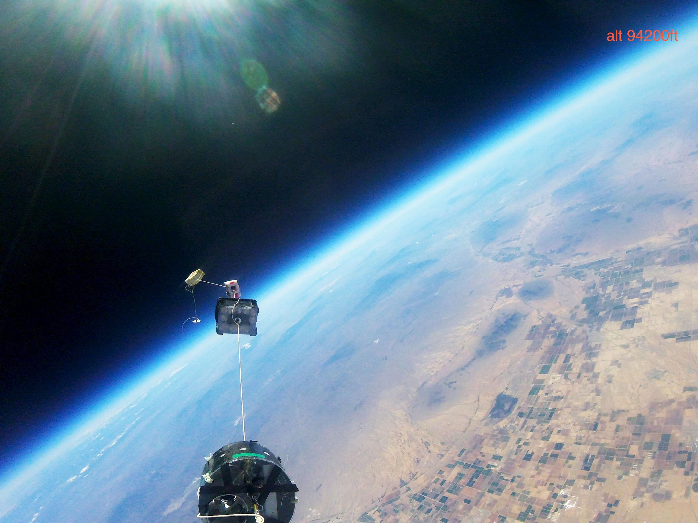





ASCENDING Further
ASCEND TEAM 2017!

Slide 2
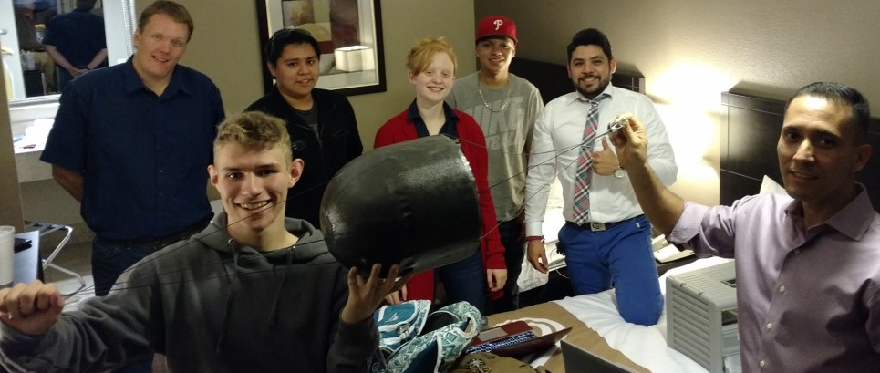
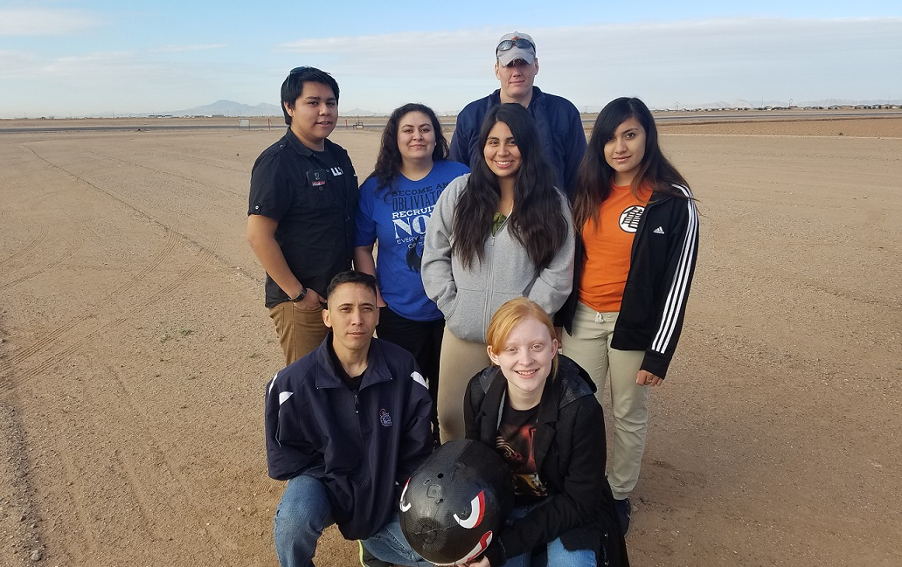
Fall 16 TEAM
Jake Denison (TL)
Ainsley Chapman
Adam Jimenez
Ian Anderson
Robert Ramirez
Adan Reyes
Brandon Lomay
Spring 17 TEAM
Adan Reyes (TL)
Adam Jimenez
Ainsley Chapman
Brandon Lomay
Ian Anderson
Angie Garcia
Rosa Mendoza
Monica Delgado

Slide 3
AGENDA
Fall 16 Launch
Mechanical
Software
Science
Results
Spring 17 Launch
Mechanical
Software
Science
Results
Conclusion
Solutions
Acknowledgements
Question & Answer

Slide 4
FALL 2016 LAUNCH
Mechanical, Software & Science

Slide 5
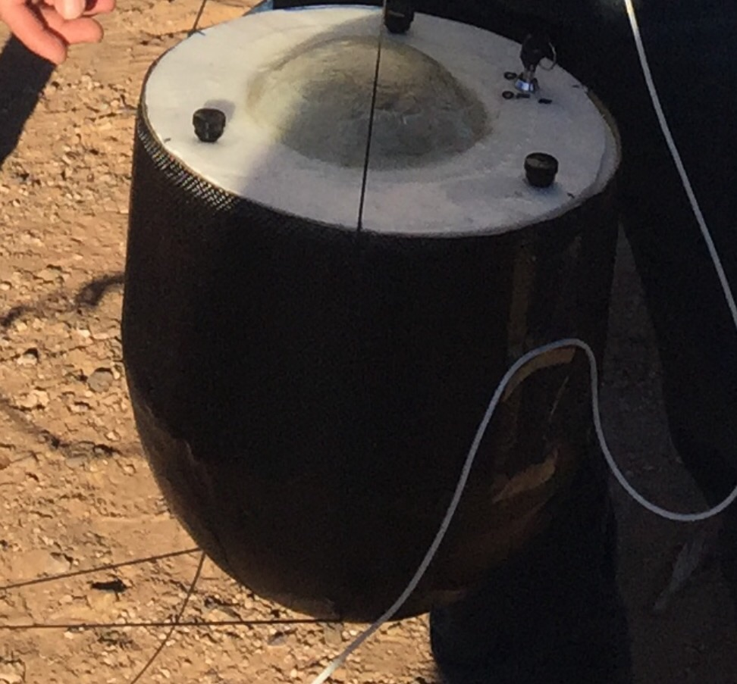
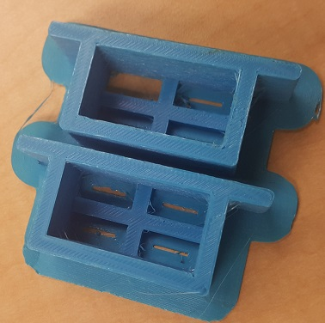
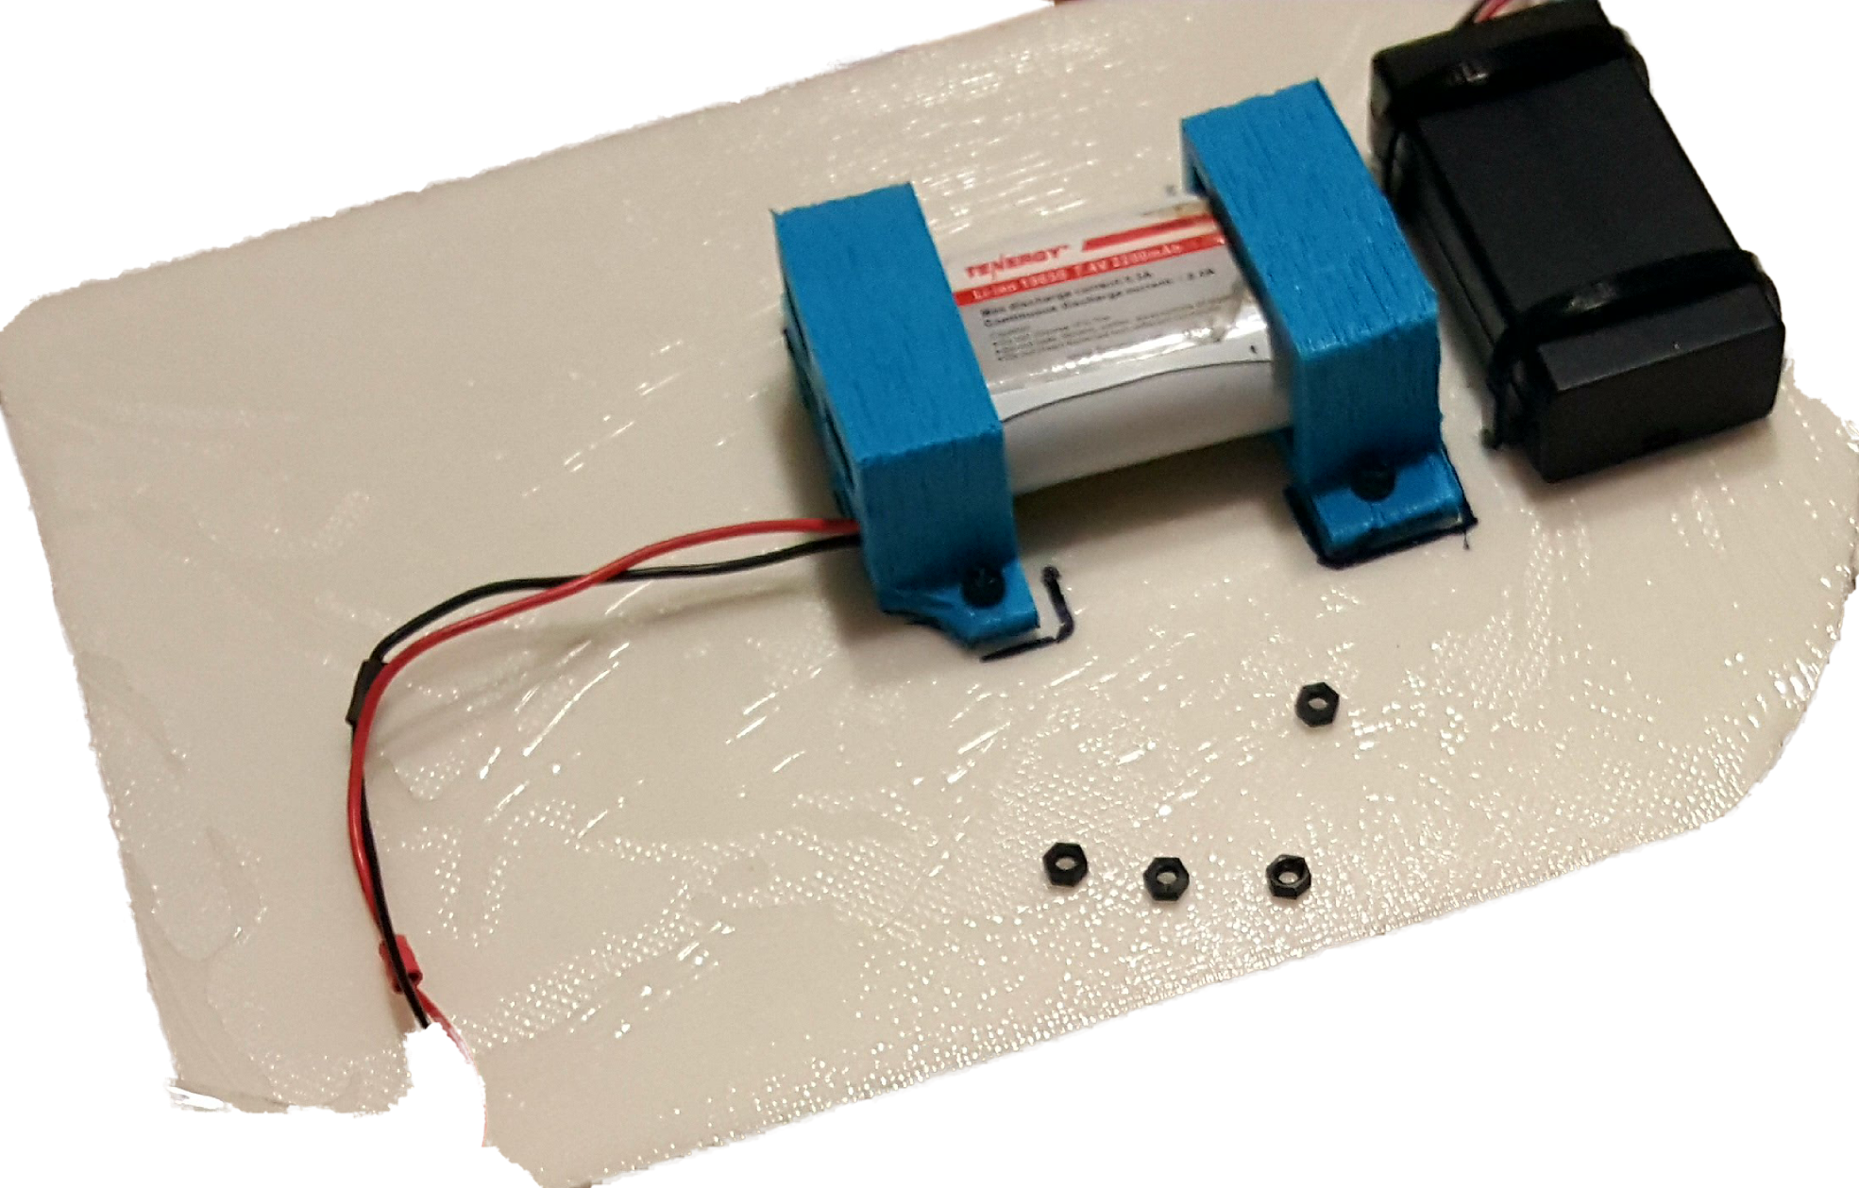
MECHANICAL Fall 2016
Carbon fiber - Hardened resin
Kevlar thread
Foam boards reinforced with fiberglass
3D printed foam board mounts
Nylon standoffs for equipment
GoPro attached with zip ties

Slide 6
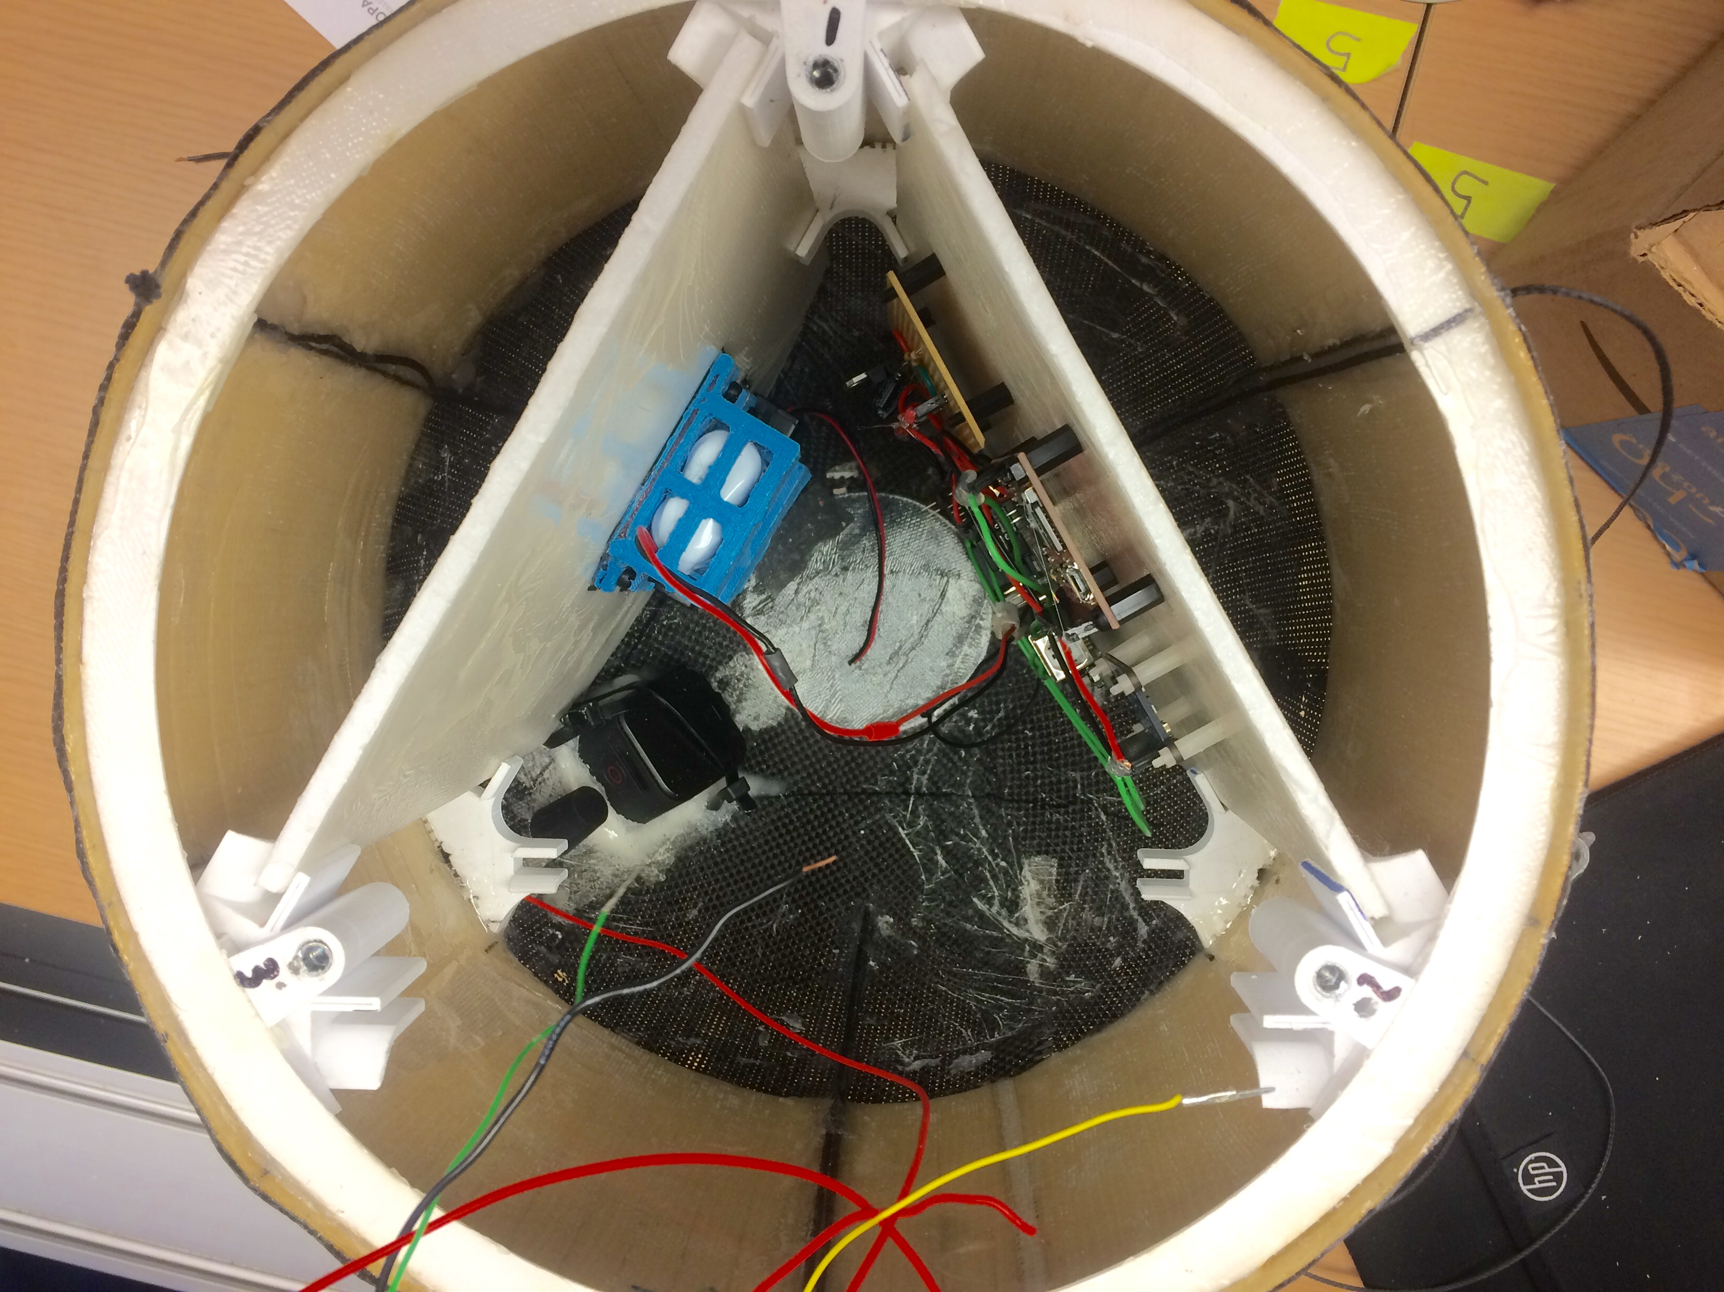
SOFTWARE Fall 2016
Electronics & Sensors
Arduino Uno
10 DOF IMU
SD Data Logger
GoPro
APRS: Automatic Packet Reporting System

Slide 7
SCIENCE Fall 2016
Anticipated Data Collection
Temperature
Barometric Pressure
Gyroscope
Compass
Accelerometer
GoPro
GPS
APRS: Automated Packet Reporting System

Slide 8
RESULTS Fall 2016

Slide 9
RESULTS Fall 2016

Slide 10
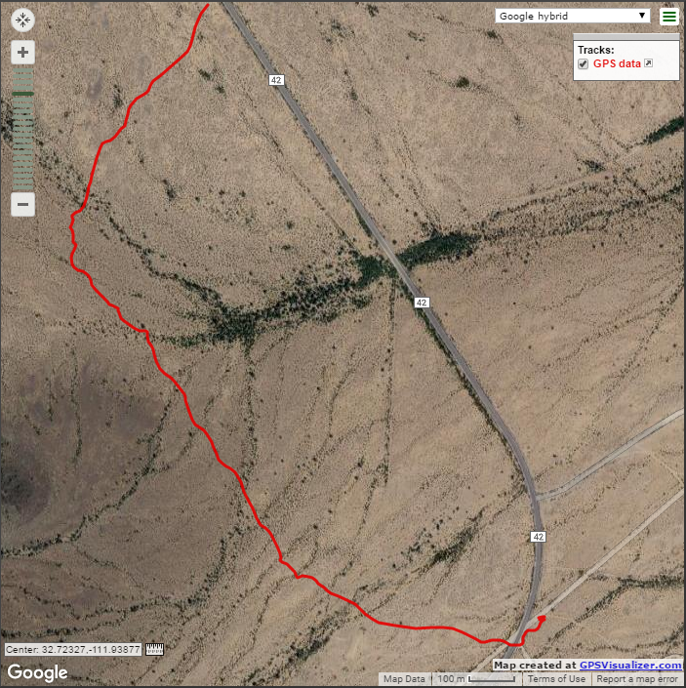
RESULTS Fall 2016

Slide 11
SPRING 2017 LAUNCH
Mechanical, Software & Science

Slide 12
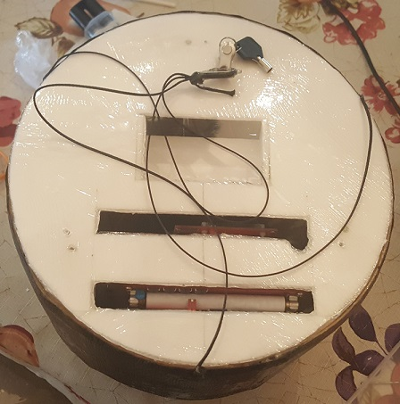
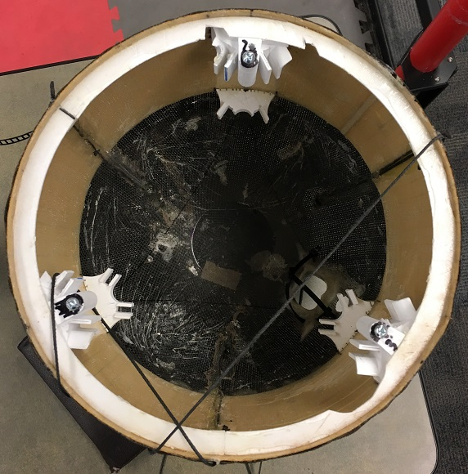
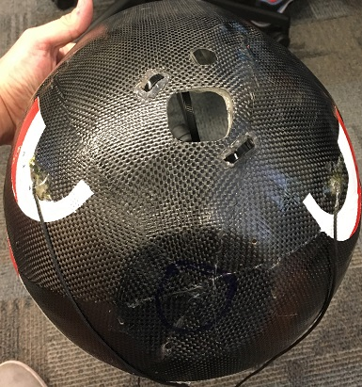
MECHANICAL Spring 2017
Carbon fiber - Hardened resin
Kevlar thread
Foam boards reinforced with fiberglass
3D printed foam board mounts
Nylon standoffs for equipment
GoPro attached with zip ties

Slide 13
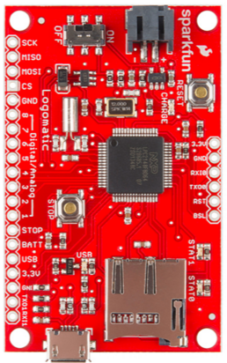
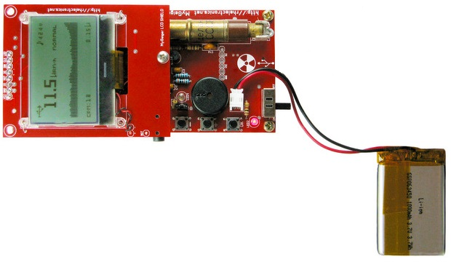
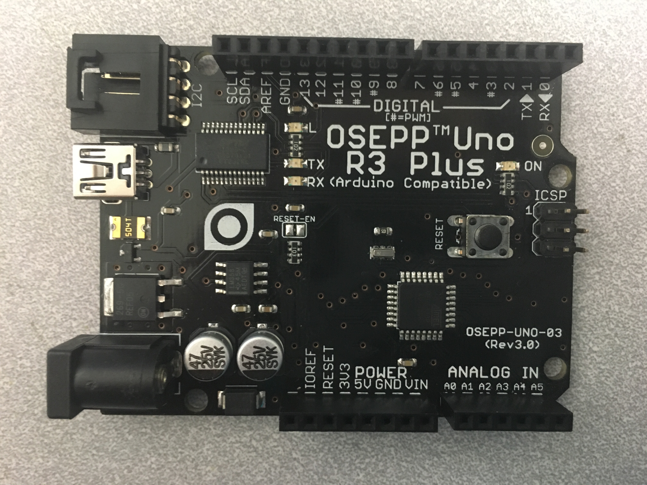
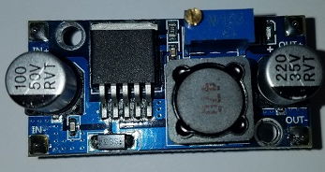
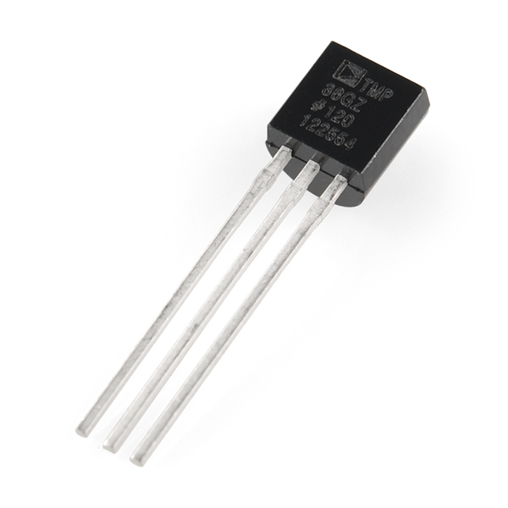
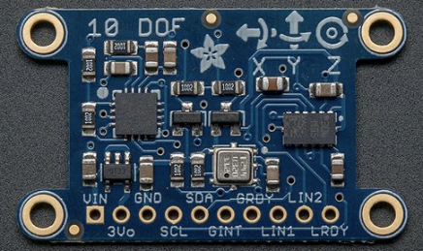
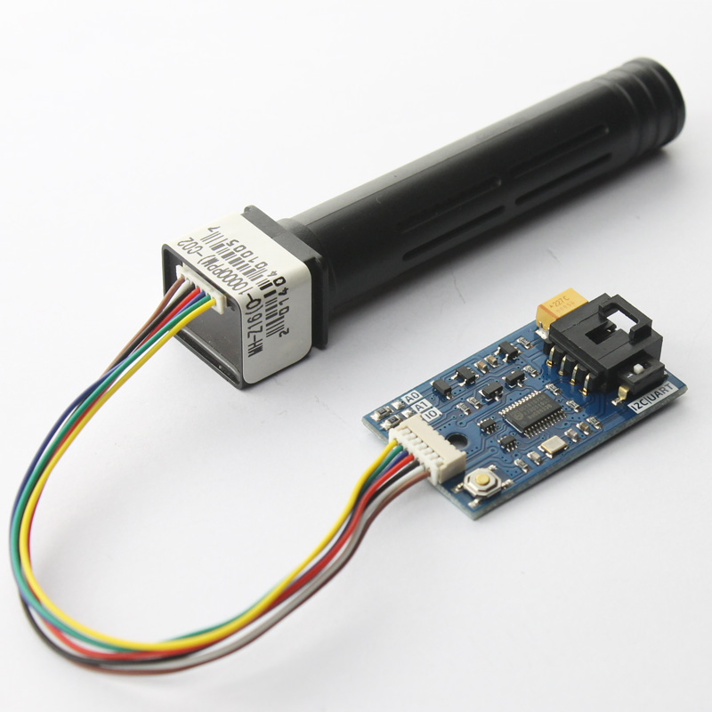
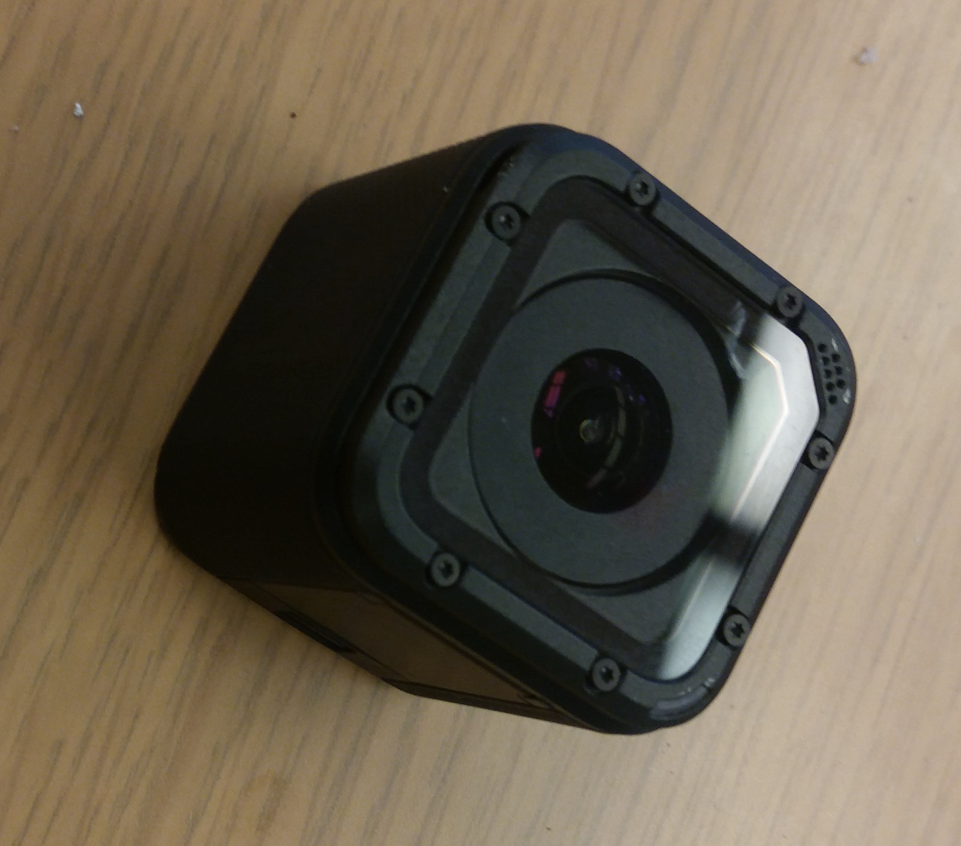
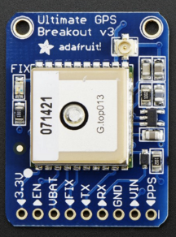
SOFTWARE Spring 2017
Electronics & Sensors
GoPro
10 DOF IMU
Arduino OSSEP
Logomatic
Voltage Regulator (3)
Ultimate GPS
Geiger Counter (3)
CO₂ Sensor
Temperature Sensor (2)

Slide 14
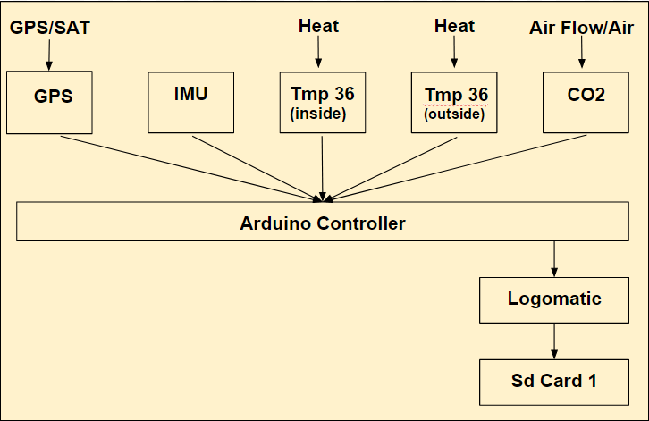
System Flow Diagram

Slide 15
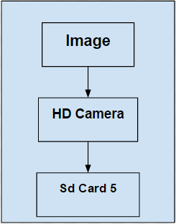
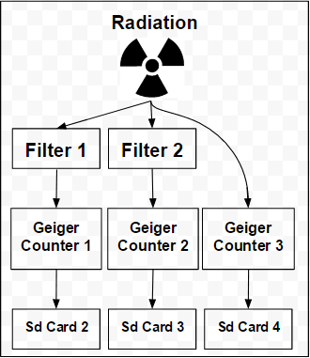
System Flow Diagram (Standalones)

Slide 16
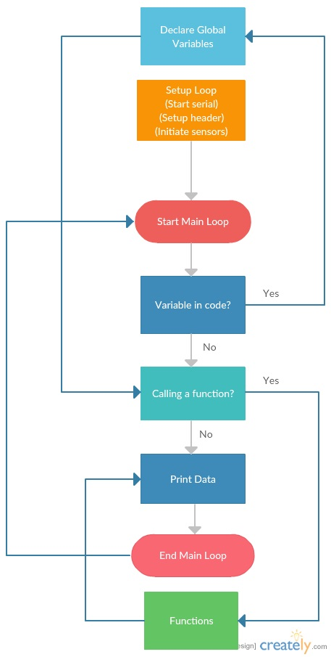
Code Flow Chart

Slide 17
SCIENCE Spring 2017
Anticipated Data Collection
Temperature
Barometric Pressure
Accelerometer
GoPro
GPS
CO₂ Sensor
3 Geiger Counters

Slide 18
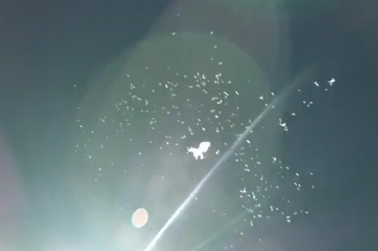
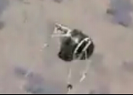
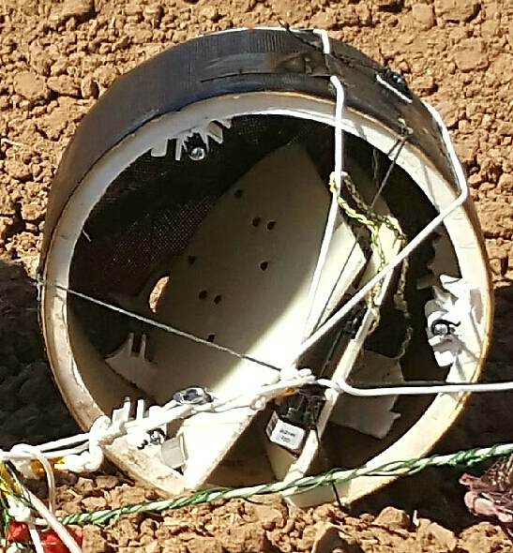
RESULTS Spring 2017
Mechanical Failures
Structural Integrity
Collision(s)
Post-Burst Conditions
No Science Data Recovery

Slide 19
CONCLUSIONS
SOLUTIONS, ACKNOWLEDGEMENTS & QUESTIONS/ANSWER

Slide 20
Solutions / Future Goals
Reinforce payload
Remote start sensors
Live Feedback & Storage of Sensor Data
Radiation Detection & Filtering
Temperature (Inside & Outside of Payload)
Payload Path Video
CO₂ Sampling

Slide 21
THANK YOU!
ASCENDING Further
ASCEND TEAM 2017
Special thanks to:
Ernest Villicaña
Dr. Ed Ong
Jack Crabtree
Paul Ronquillo

Slide 22
QUESTIONS?

